Slide 1

About OpenVAS
Process
Flowchart
Key Features
OpenVAS (Greenbone)

Slide 2
About OpenVAS :
A powerful open source tool for locating and controlling security flaws in networks and systems is OpenVAS (Open Vulnerability Assessment Scanner), which is now frequently linked to Greenbone. It identifies possible security flaws, does automated vulnerability scans and provides thorough remedial guidance.
Standards

Slide 3
Process
Step 1: Enter Target or Hostname • Enter the IP address or hostname of the system you want to analyze.
Example: 192.168.1.10 Step 2: Choose a Scan Profile • Select an appropriate scan profile depending on the level of assessment needed:
- Quick Scan for faster, lighter checks
- Full and Deep Scan for thorough security analysis
- Web Application Scan for testing websites
- Custom Profile for user-specific configurations
Step 3: Set Scan Schedule (Optional) • Decide whether to run the scan immediately or schedule it for a later date and time.
Example: "Run Immediately" or "Schedule for Later"
Click on the model to interact

Slide 4
2. Relation between Earth, Sun, and Moon
Step 4: Launch the Scan • Click the Start Scan button to begin the vulnerability assessment. Step 5: Observe Scan Progress • Monitor the scan's status and progress in real time through the interface. Step 6: Review and Analyze the Report • Once the scan is complete, examine the detailed report, which includes discovered vulnerabilities, their severity and recommended remediation steps.
Let's look at an output example:
• openvas -T 192.168.1.10 --profile=Full_and_Deep --report=html
Now lets breakdown the command-
• -T 192.168.1.10: Specifies the IP address or hostname of the target system to be scanned.
• --profile=Full_and_Deep: Selects the "Full and Deep" scan profile for an in depth vulnerability assessment.
• --report=html: Generates the scan results in an HTML format for easy viewing and sharing.

Slide 5
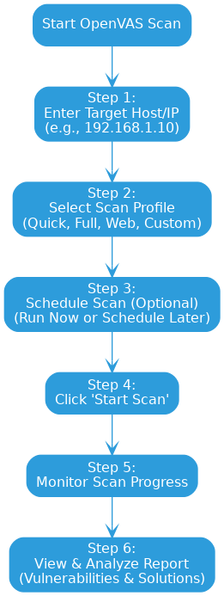
Flowchart

Slide 6
Key Features
• Threat Identification:
Detects and flags a broad spectrum of recognized security vulnerabilities across systems.
• Extensive Scanning Coverage:
Performs in depth scans across entire networks, including hosts, devices and services.
• Continuous Database Updates:
Maintains an up to date vulnerability feed to stay aligned with the latest threat intelligence.
• Risk Based Prioritization:
Assesses and ranks vulnerabilities based on their potential impact and severity.
• In-Depth Reporting:
Delivers detailed, actionable reports to help security teams understand issues and apply fixes effectively.

